Slide 1
Mopub Documentation

Slide 2
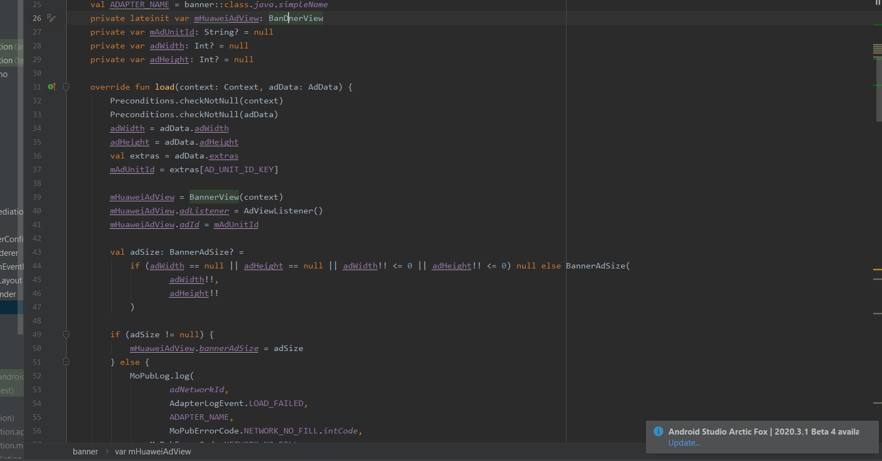
Huawei Ads adapter code
Code link: https://github.com/clho40/Mediation/tree/main/mediation_adapter_mopub

Slide 3
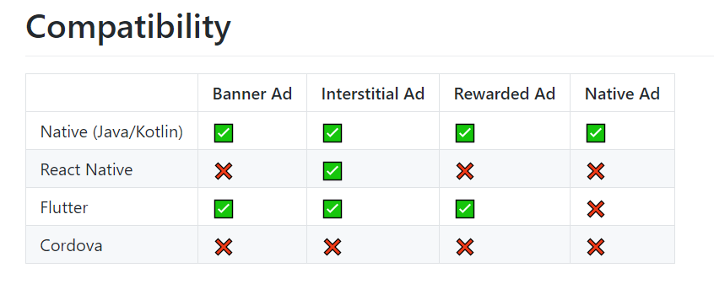
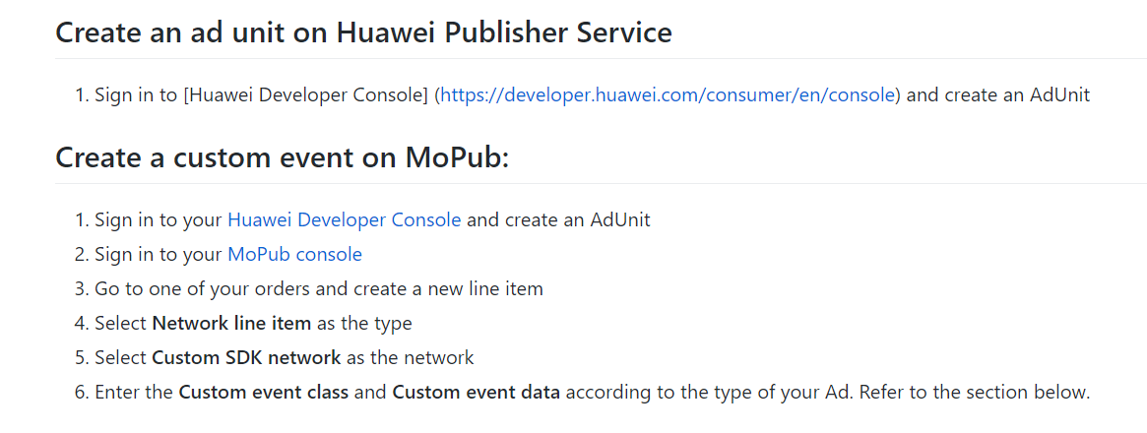
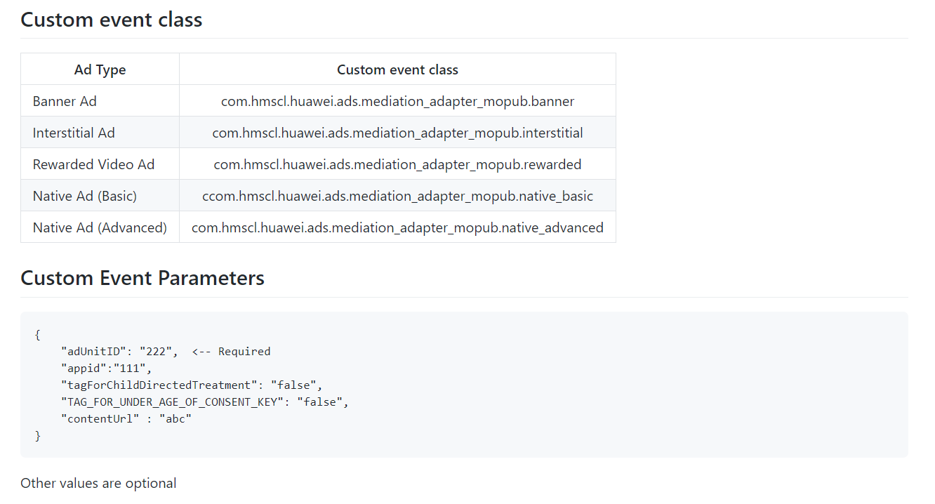
Custom event classes with Mopub

Slide 4
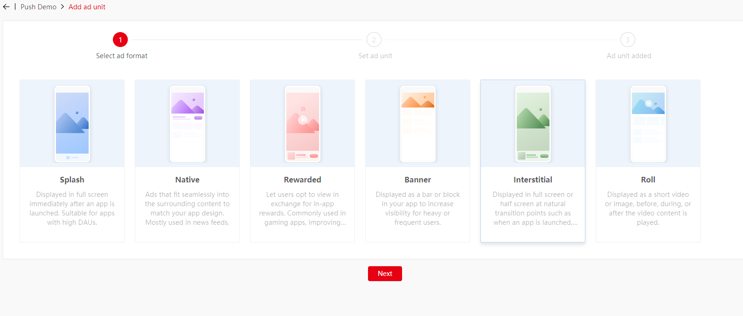
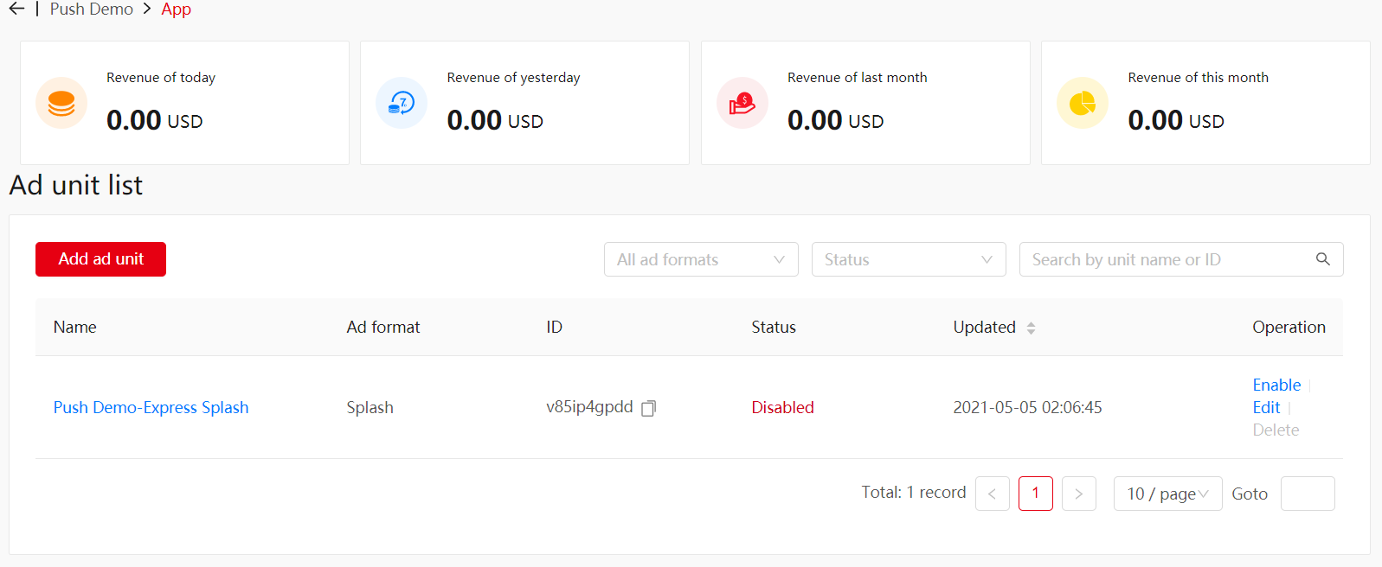
MoPub Mediation Demo Workflow for Interstitial ads
1. Huawei Ads Console Setup for Ad Unit for CP app based on type of ads.
MoPub supports Interstitial, Banner, Rewarded, and Native shown below.
We skipped this set up since we are going to use test AdunitID instead of real adunitID from the release app. (Our demo is not published in AG)

Slide 5
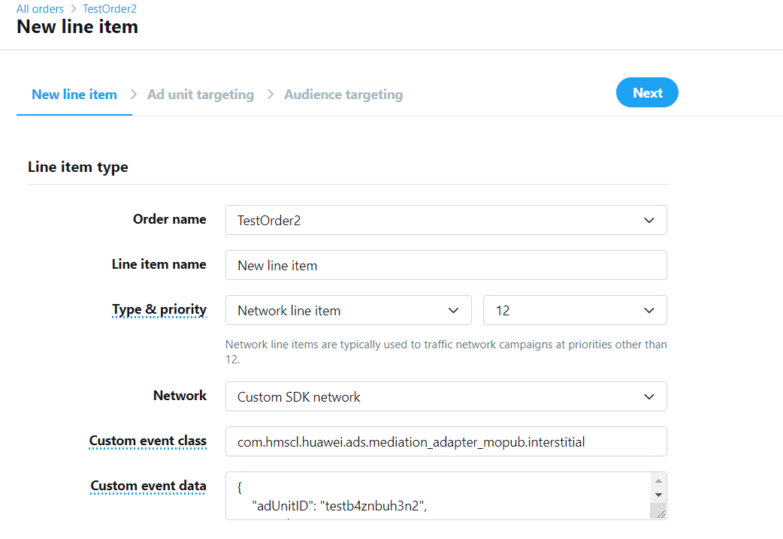
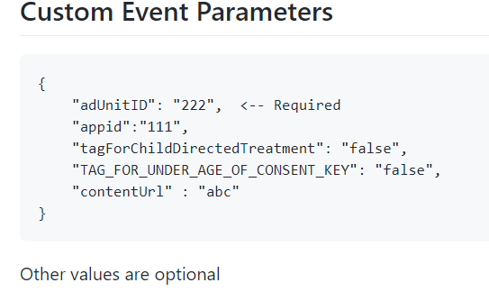
MoPub Mediation Demo Workflow for Interstitial ads
2. MoPub Console Setup for CP App ; add new ad unit for FullI Screen(Interstitial) ad type with custom event class and Custom Event data from information from Huawei Console
3. Show demo app for four type ads : Interstitial, Banner, Rewarded, and Native
Information from Huawei Console
Information from Huawei Github Code

Slide 6
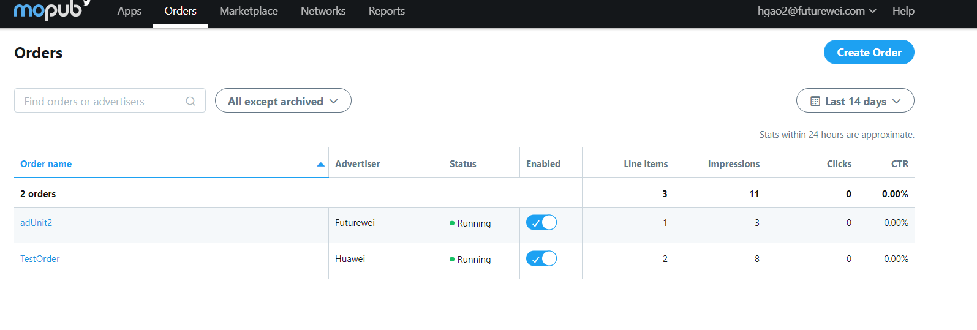
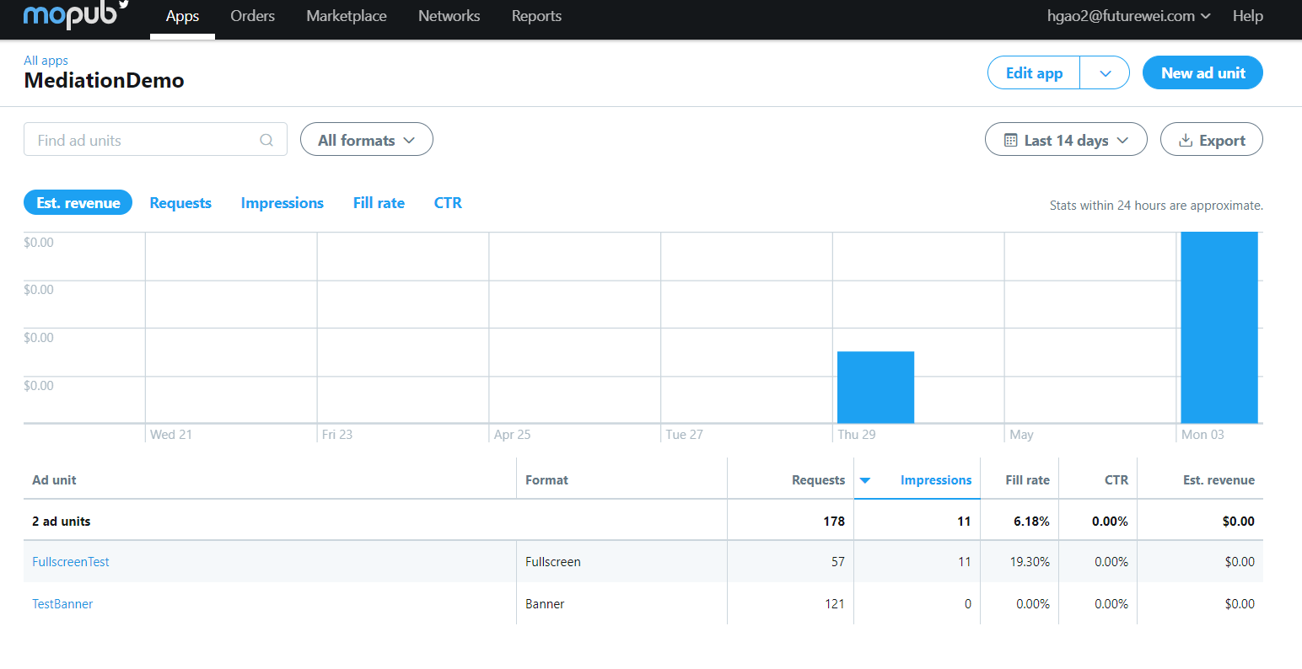
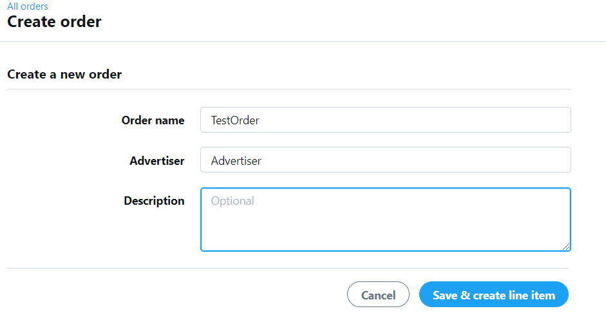
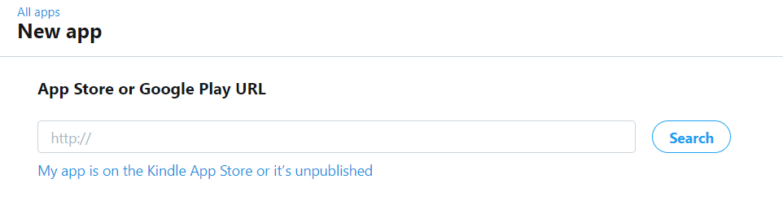
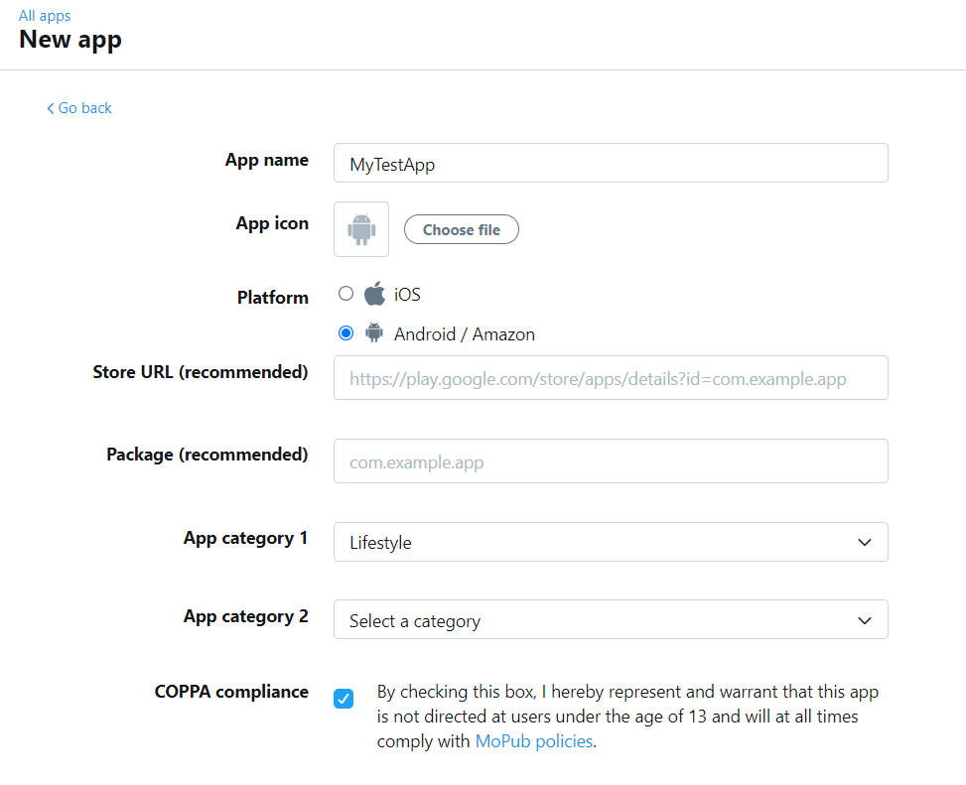
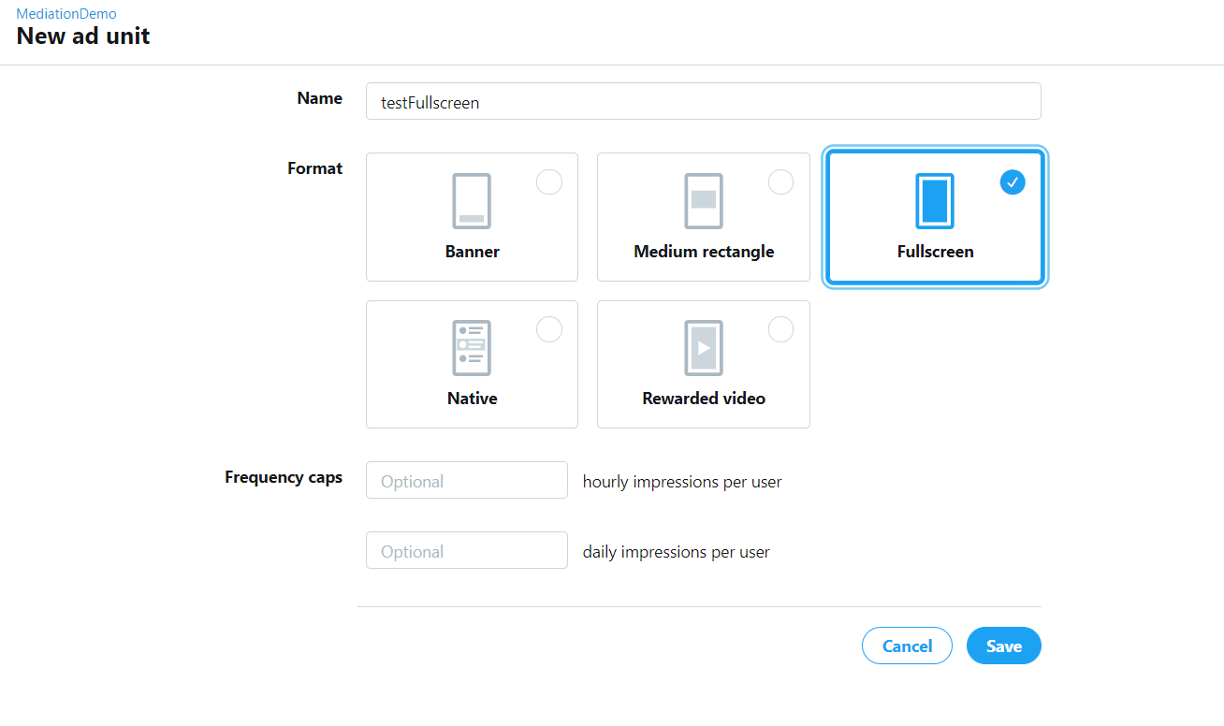
MoPub Console Setup Workflow for CP App
On Mopub console, navigate to Apps tab and select New App.
Navigate into app and select New ad unit
Navigate into orders and create order
If unpublished, select unpublished and fill out application information
Fill out ad unit information (using fullscreen as example)

Slide 7
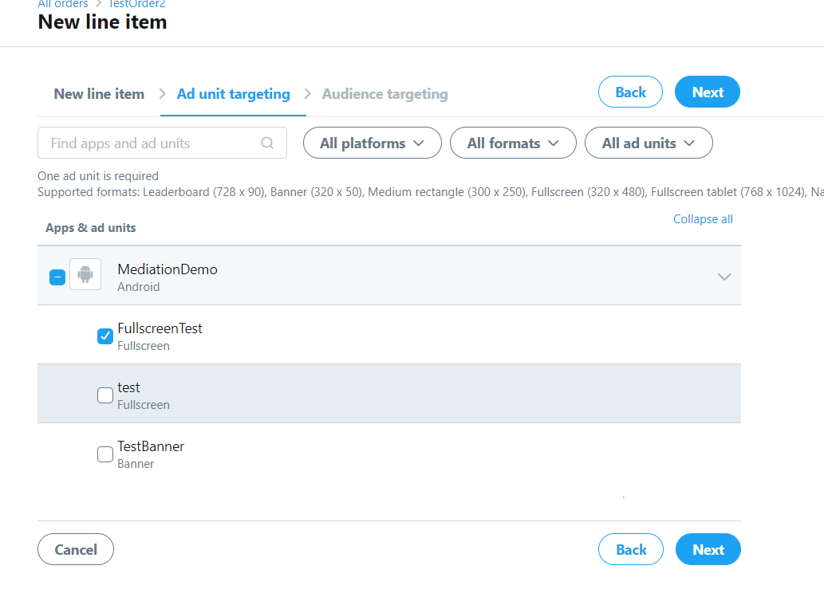
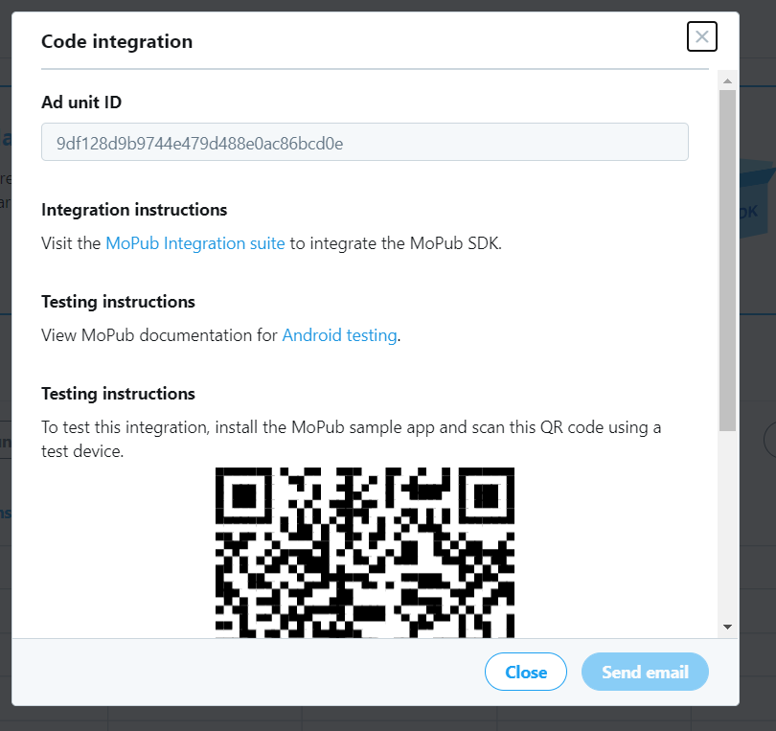
Create new line item, filling out the information
Target the ad unit you created previously
Use the ad unit id to integrate the ad into your application.

Slide 8
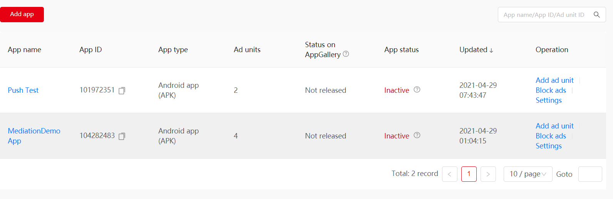
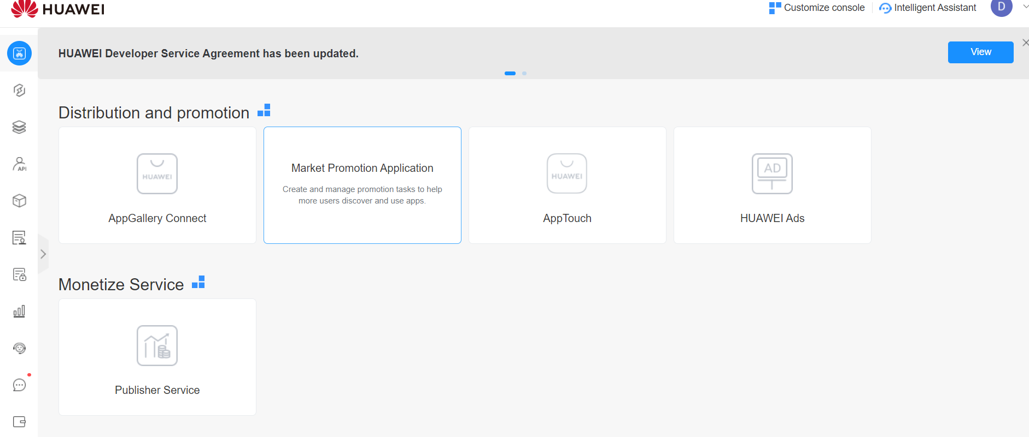
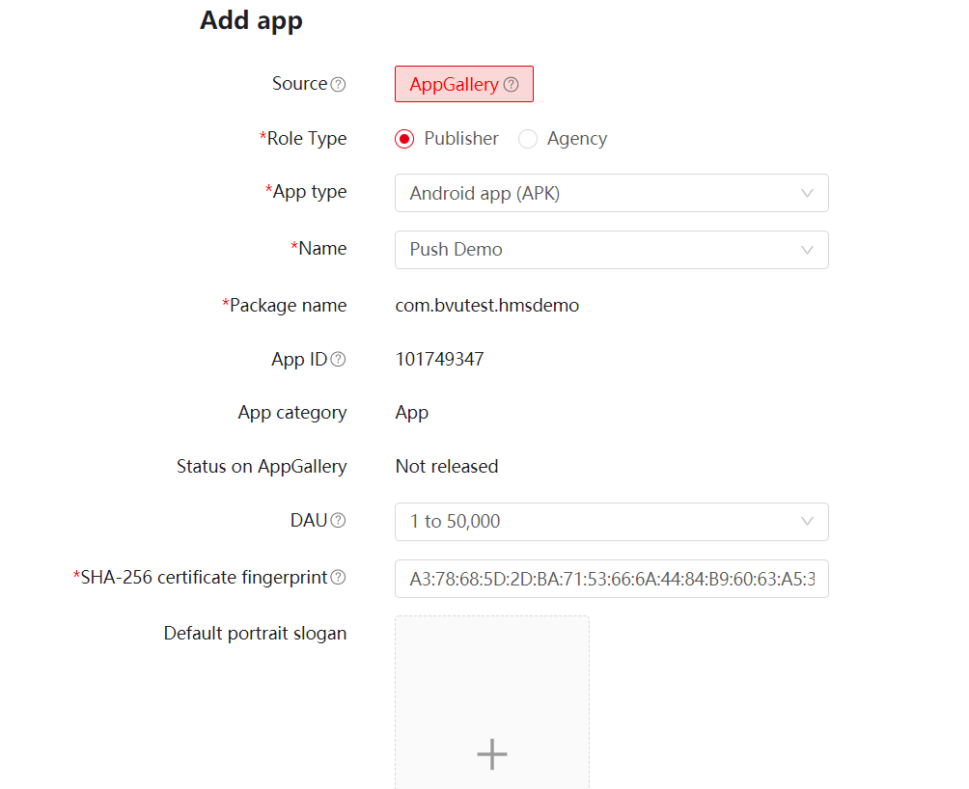
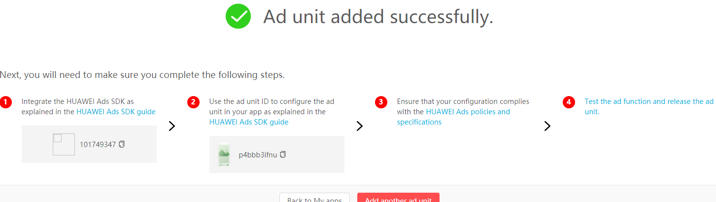
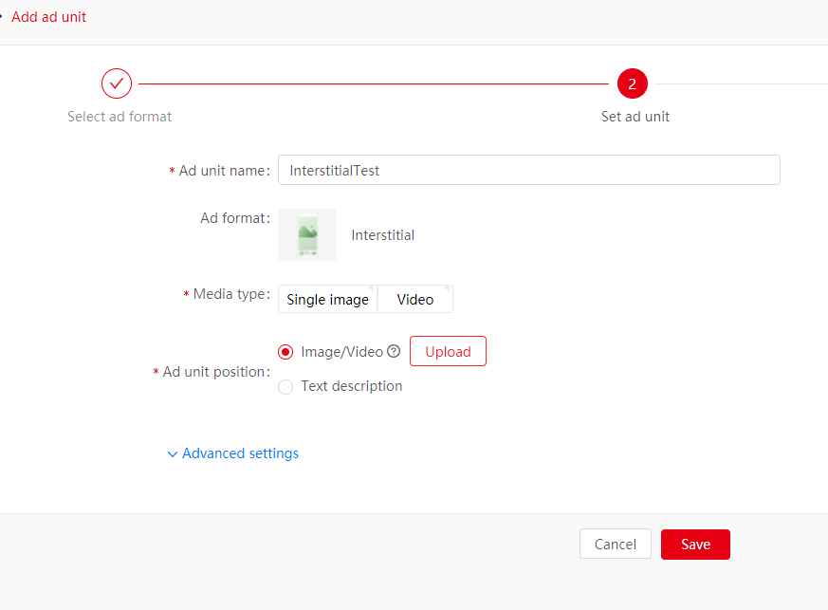
MoPub Console Setup Workflow for CP App
On your ads publisher console, select my apps and add an app. This app must have been integrated into your Appgallery connect for it to show up.
Add an ad unit, using interstitial as example.
Sign into your enterprise Futurewei account and access Publisher Service
Use the app id and the ad id to integrate the ads into your application
Fill ad unit information and append image/video of ad

Slide 9
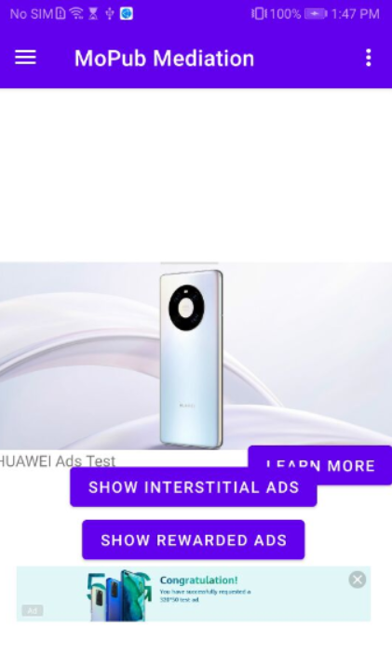
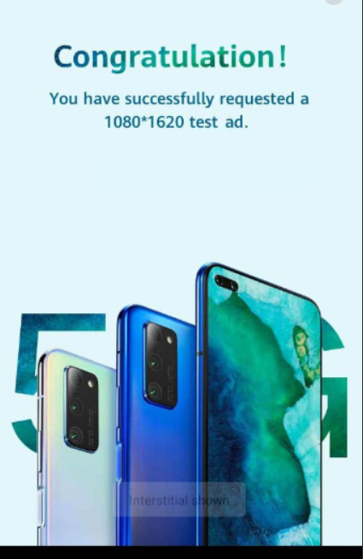
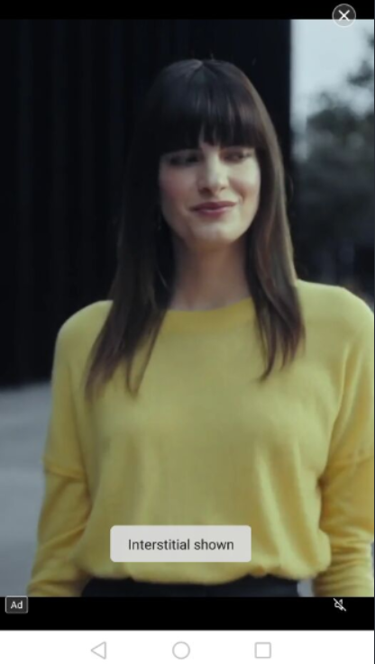
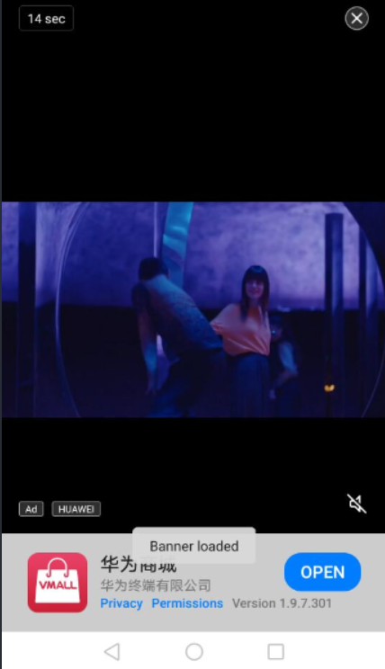
Native Ad
OR (Multiple ad source example
Fullscreen/Interstitial Ads
Rewarded Video Ad
Banner Ad

